Slide 1




Multidimensional Arrays
Processing Matrices, Jagged Arrays
Advanced
C#
SoftUni Team
Technical Trainers
Software University
http://softuni.bg

Slide 2


Table of Contents
Matrices and Multidimensional Arrays
Jagged Arrays (arrays of arrays)
Sorting Arrays

Slide 3
Questions
sli.do #CSharp-Fund

Slide 4
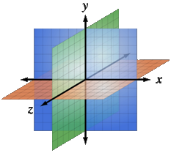
Multidimensional Arrays
Using Array of Arrays, Matrices and Cubes

Slide 5
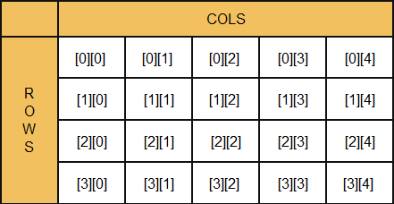
What is Multidimensional Array?
Array is a systematic arrangement of similar objects
Multidimensional arrays have more than one dimension
The most used multidimensional arrays are the 2-dimensional
Row Index
Col Index

Slide 6
What is Multidimensional Array?
Multidimensional arrays have more than one dimension
The most used multidimensional arrays are the 2-dimensional
Known as matrices or tables
0 1 2
0
1
2
4 | 6 | 3
2 | 1 | 2
6 | 7 | 9
One main array whose elements are arrays

Slide 7
Declaring and Creating Multidimensional Arrays
Declaring multidimensional arrays:
Creating a multidimensional array
Use the new keyword
Must specify the size of each dimension
int[,] intMatrix;
float[,] floatMatrix;
string[,,] strCube;
int[,] intMatrix = new int[3, 4];
float[,] floatMatrix = new float[8, 2];
string[,,] stringCube = new string[5, 5, 5];

Slide 8
Initializing Multidimensional Arrays
Initializing with values multidimensional array:
Matrices are represented by a list of rows
Rows consist of list of values
The first dimension comes first, the second comes next (inside the first)
int[,] matrix =
{
{1, 2, 3, 4}, // row 0 values
{5, 6, 7, 8} // row 1 values
};

Slide 9
Accessing Elements
Accessing N-dimensional array element:
Getting element value:
Setting element value:
nDimensionalArray[index₁, … , index_{n}]
int[,] array = {{1, 2}, {3, 4}}
int element11 = array[1, 1]; // element11 = 4
int[,] array = new int[3, 4];
for (int row = 0; row < array.GetLength(0); row++)
for (int col = 0; col < array.GetLength(1); col++)
array[row, col] = row + col;

Slide 10
Printing Matrix – Example
int[,] matrix =
{ { 5, 2, 3, 1 },
{ 1, 9, 2, 4 },
{ 9, 8, 6, 11 } };
for (int row = 0; row < matrix.GetLength(0); row++)
{
for (int col = 0; col < matrix.GetLength(1); col++)
{
Console.Write("{0} ", matrix[row, col]);
}
Console.WriteLine();
}
Gets length of 0th dimension (rows)

Slide 11
Problem: Sum of All Elements of Matrix
Read a matrix from the console
Print the number of rows
Print the number of columns
Print the sum of all numbers in the matrix
int[,] matrix = {
{ 5, 2, 3, 1 },
{ 1, 9, 2, 4 },
{ 9, 8, 6, 9 }
};
3
5
59

Slide 12
Solution: Sum of All Elements of Matrix
Gets length of 0th dimension (rows)
int sum = 0;
for (int row = 0; row < matrix.GetLength(0); row++)
{
for (int col = 0; col < matrix.GetLength(1); col++)
{
sum += matrix[row, col];
}
}
Console.WriteLine(sum);
Gets length of 1st dimension (columns)
Check your solution here: https://judge.softuni.bg/Contests/Practice/Index/599#0

Slide 13
Problem: Find Specific Square in Matrix
Find 2x2 square with max sum in given matrix
Read matrix from the console
Find biggest sum of 2x2 submatrix
Print result like new matrix
int[,] matrix = {
{7, 1, 3, 3, 2, 1},
{1, 3, 9, 8, 5, 6},
{4, 6, 7, 9, 1, 0} };
9 8
7 9
33

Slide 14
Solution: Find Specific Square in Matrix
for (int rowIndex = 0; rowIndex < matrix.Length - 1;
rowIndex++)
{
for (int colIndex = 0;
colIndex < matrix[rowIndex].Length - 1; colIndex++)
{
var newSquareSum = matrix[rowIndex, colIndex] +
matrix[rowIndex + 1, colIndex] +
matrix[rowIndex, colIndex + 1] +
matrix[rowIndex + 1, colIndex + 1];
//TODO: Check if sum is bigger
}
}
Check your solution here: https://judge.softuni.bg/Contests/Practice/Index/599#1

Slide 15

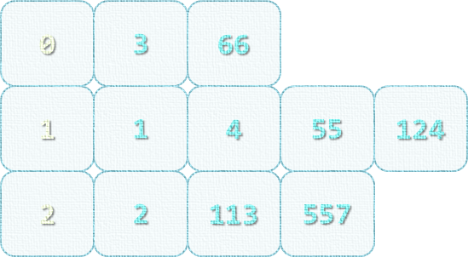
Jagged Arrays
Definition, Usage

Slide 16
Jagged Arrays
Jagged arrays are multidimensional arrays
But each dimension has different size
A jagged array is an array of arrays
Each of the arrays has different length
 | 0 | 1 | 2 | 3
0 | 7 | 3 | 4 | 2
1 | 5 | 1
2 | 9 | 3 | 1
int[][] jagged = new int[3][];
jagged[0] = new int[3];
jagged[1] = new int[2];
jagged[2] = new int[5];

Slide 17
Filling a Jagged Array
int[][] jagged = new int[5][];
for (int i = 0; i < jagged.Length; i++)
{
string[] inputNumbers = Console.ReadLine().Split(' ');
jagged[i] = new int[inputNumbers.Length];
for (int j = 0; j < jagged[i].Lenght; j++)
{
jagged[i][j] = int.Parse(inputNumbers[j]);
}
}

Slide 18
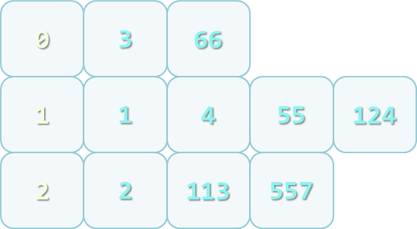
Problem: Group Numbers
Read a set of numbers and group them by their remainder when dividing to 3 (0, 1 and 2)
1, 4,
113, 55,
3, 1,
2, 66,
557, 124,
2

Slide 19
Solution: Group Numbers
int[] numbers = { 1, 4, 113, 55, 3, 1, 2, 66, 557, 124, 2 };
int[] sizes = new int[3];
foreach (var number in numbers)
{
int remainder = number % 3;
sizes[remainder]++;
}
int[][] array =
{
new int[sizes[0]],
new int[sizes[1]],
new int[sizes[2]]
};

Slide 20
Solution: Group Numbers (2)
int[] offsets = new int[3];
foreach (var number in numbers)
{
int remainder = number % 3;
int index = offsets[remainder];
array[remainder][index] = number;
offsets[remainder]++;
}
Check your solution here: https://judge.softuni.bg/Contests/Practice/Index/599#2

Slide 21
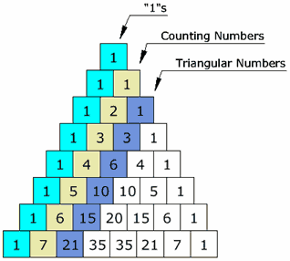
Problem: Pascal Triangle
Write a program which prints on the console a Pascal Triangle

Slide 22
Solution: Pascal Triangle
var height = int.Parse(Console.ReadLine());
int[][] triangle = new int[height][];
int currentWidth = 1;
for (int height = 0; height < rows; height++)
{
triangle[height] = new int[currentWidth];
int[] currentRow = triangle[height];
currentRow[0] = 1;
currentRow[currentRow.Length - 1] = 1;
currentWidth++;
//TODO: Fill elements for each row (next slide)
}

Slide 23
Solution: Pascal Triangle (2)
if (currentRow.Length > 2)
{
for (int i = 1; i < currentRow.Length - 1; i++)
{
int[] previousRow = triangle[height - 1];
int prevoiousRowSum = previousRow[i] + previousRow[i - 1];
currentRow[i] = prevoiousRowSum;
}
}
Check your solution here: https://judge.softuni.bg/Contests/Practice/Index/599#3

Slide 24

Summary
Multidimensional arrays
Have more than one dimension
Two-dimensional arrays are like tables
with rows and columns
Jagged arrays
Arrays of arrays
Each element is an array itself

Slide 25







Multidimensional Arrays
https://softuni.bg/courses/csharp-advanced

Slide 26
License
This course (slides, examples, demos, videos, homework, etc.) is licensed under the "Creative Commons Attribution-NonCommercial-ShareAlike 4.0 International" license
Attribution: this work may contain portions from
"Fundamentals of Computer Programming with C#" book by Svetlin Nakov & Co. under CC-BY-SA license
"C# Part I" course by Telerik Academy under CC-BY-NC-SA license
"C# Part II" course by Telerik Academy under CC-BY-NC-SA license

Slide 27





Trainings @ Software University (SoftUni)
Software University – High-Quality Education, Profession and Job for Software Developers
softuni.bg
Software University Foundation
http://softuni.foundation/
Software University @ Facebook
facebook.com/SoftwareUniversity
Software University Forums
forum.softuni.bg

